Slide 1


ISBS-MBA Placement (Batch 2017-19 to 2021-23)
💡 Insights:
The analysis of the visualizations within the dashboard has yielded several compelling insights that shed light on the placement scenario at ISBS College:
1️The highest package offered stands at an impressive 13.58 LPA, courtesy of Federal Bank, for students specializing in Finance.
2️The average package for the most recent batch (2021-2023) hovers around 6.85 LPA, indicative of promising opportunities for aspiring students.
3️Marketing specialization emerges as the favored choice of students with 52.8% .
4️HDFC Bank has consistently participated in the college's placement drives for the past five years, demonstrating their commitment to hiring talent from ISBS College.
5️The ratio of companies to students has shown a positive trend, with an approximate ratio of 1:2, signifying an improving placement scenario year by year.
Data Source - https://indiraisbs.edu.in/#/placement-report

Slide 2
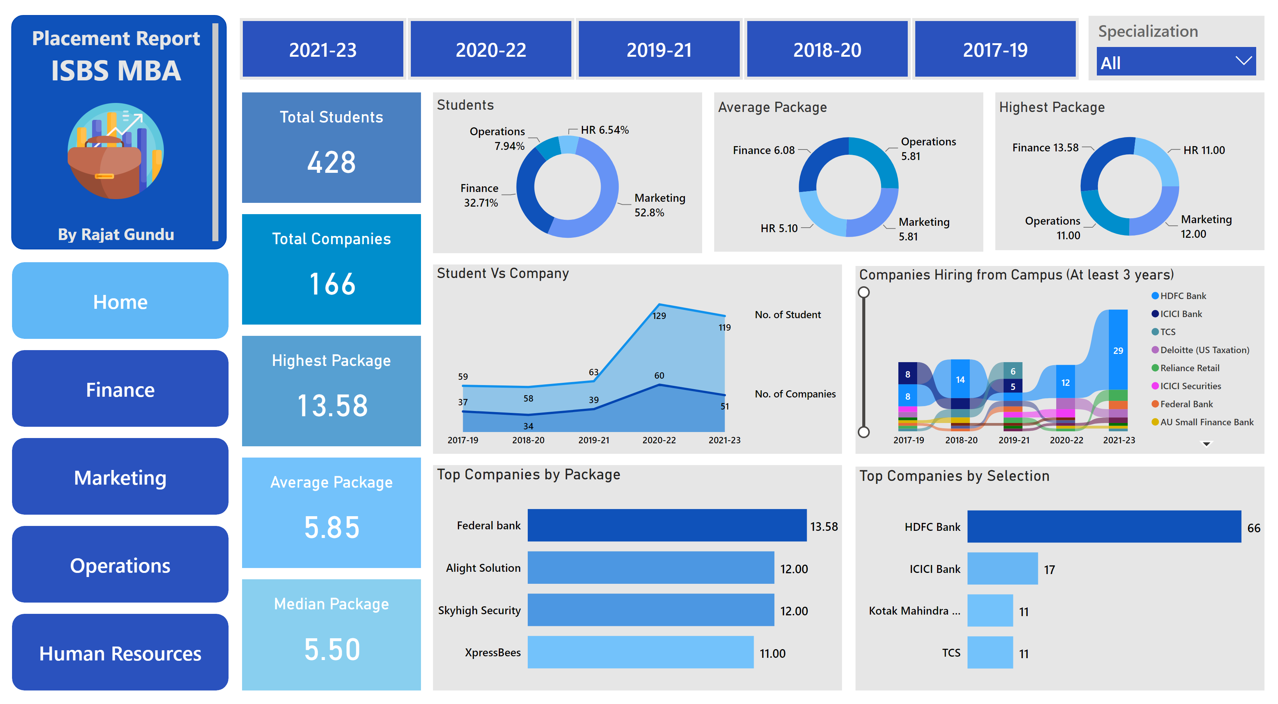
Home
Notes:
textbox
No alt text provided
image
No alt text provided
Total Students
No alt text provided
Highest Package
No alt text provided
Median Package
No alt text provided
Average Package
No alt text provided
Students
No alt text provided
Average Package
No alt text provided
Top Companies by Package
No alt text provided
Top Companies by Selection
No alt text provided
Highest Package
No alt text provided
slicer
No alt text provided
slicer
No alt text provided
Student Vs Company
No alt text provided
Total Companies
No alt text provided
shape
No alt text provided
shape
No alt text provided
shape
No alt text provided
shape
No alt text provided
shape
No alt text provided
Companies Hiring from Campus (At least 3 years)
No alt text provided

Slide 3
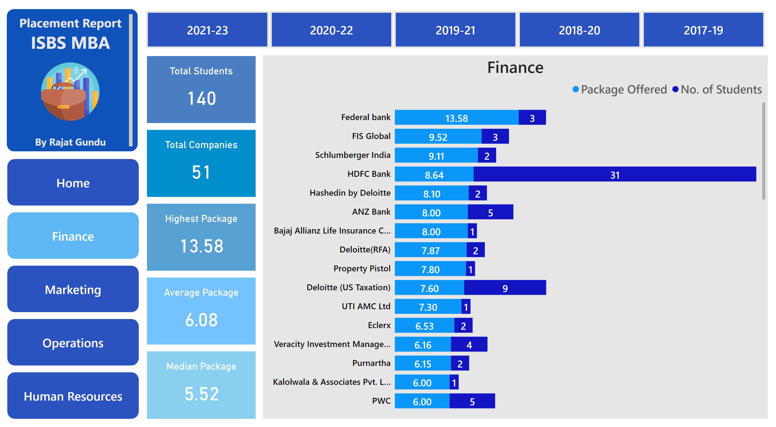
Finance
Notes:
textbox
No alt text provided
image
No alt text provided
slicer
No alt text provided
Finance
No alt text provided
shape
No alt text provided
shape
No alt text provided
shape
No alt text provided
shape
No alt text provided
shape
No alt text provided
Total Students
No alt text provided
Total Companies
No alt text provided
Highest Package
No alt text provided
Average Package
No alt text provided
Median Package
No alt text provided

Slide 4
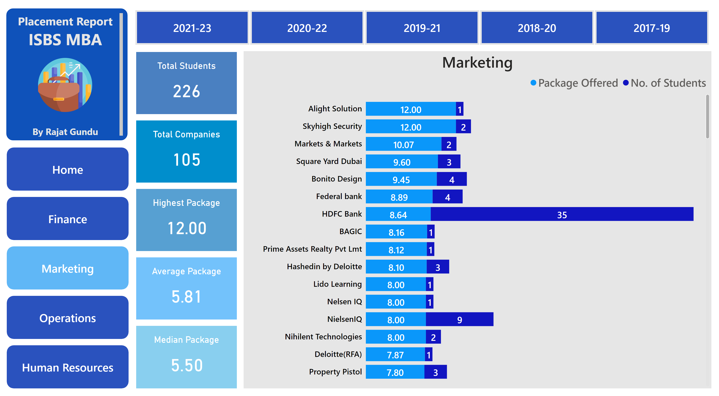
Marketing
Notes:
textbox
No alt text provided
image
No alt text provided
slicer
No alt text provided
Marketing
No alt text provided
shape
No alt text provided
shape
No alt text provided
shape
No alt text provided
shape
No alt text provided
shape
No alt text provided
Total Students
No alt text provided
Total Companies
No alt text provided
Highest Package
No alt text provided
Average Package
No alt text provided
Median Package
No alt text provided

Slide 5
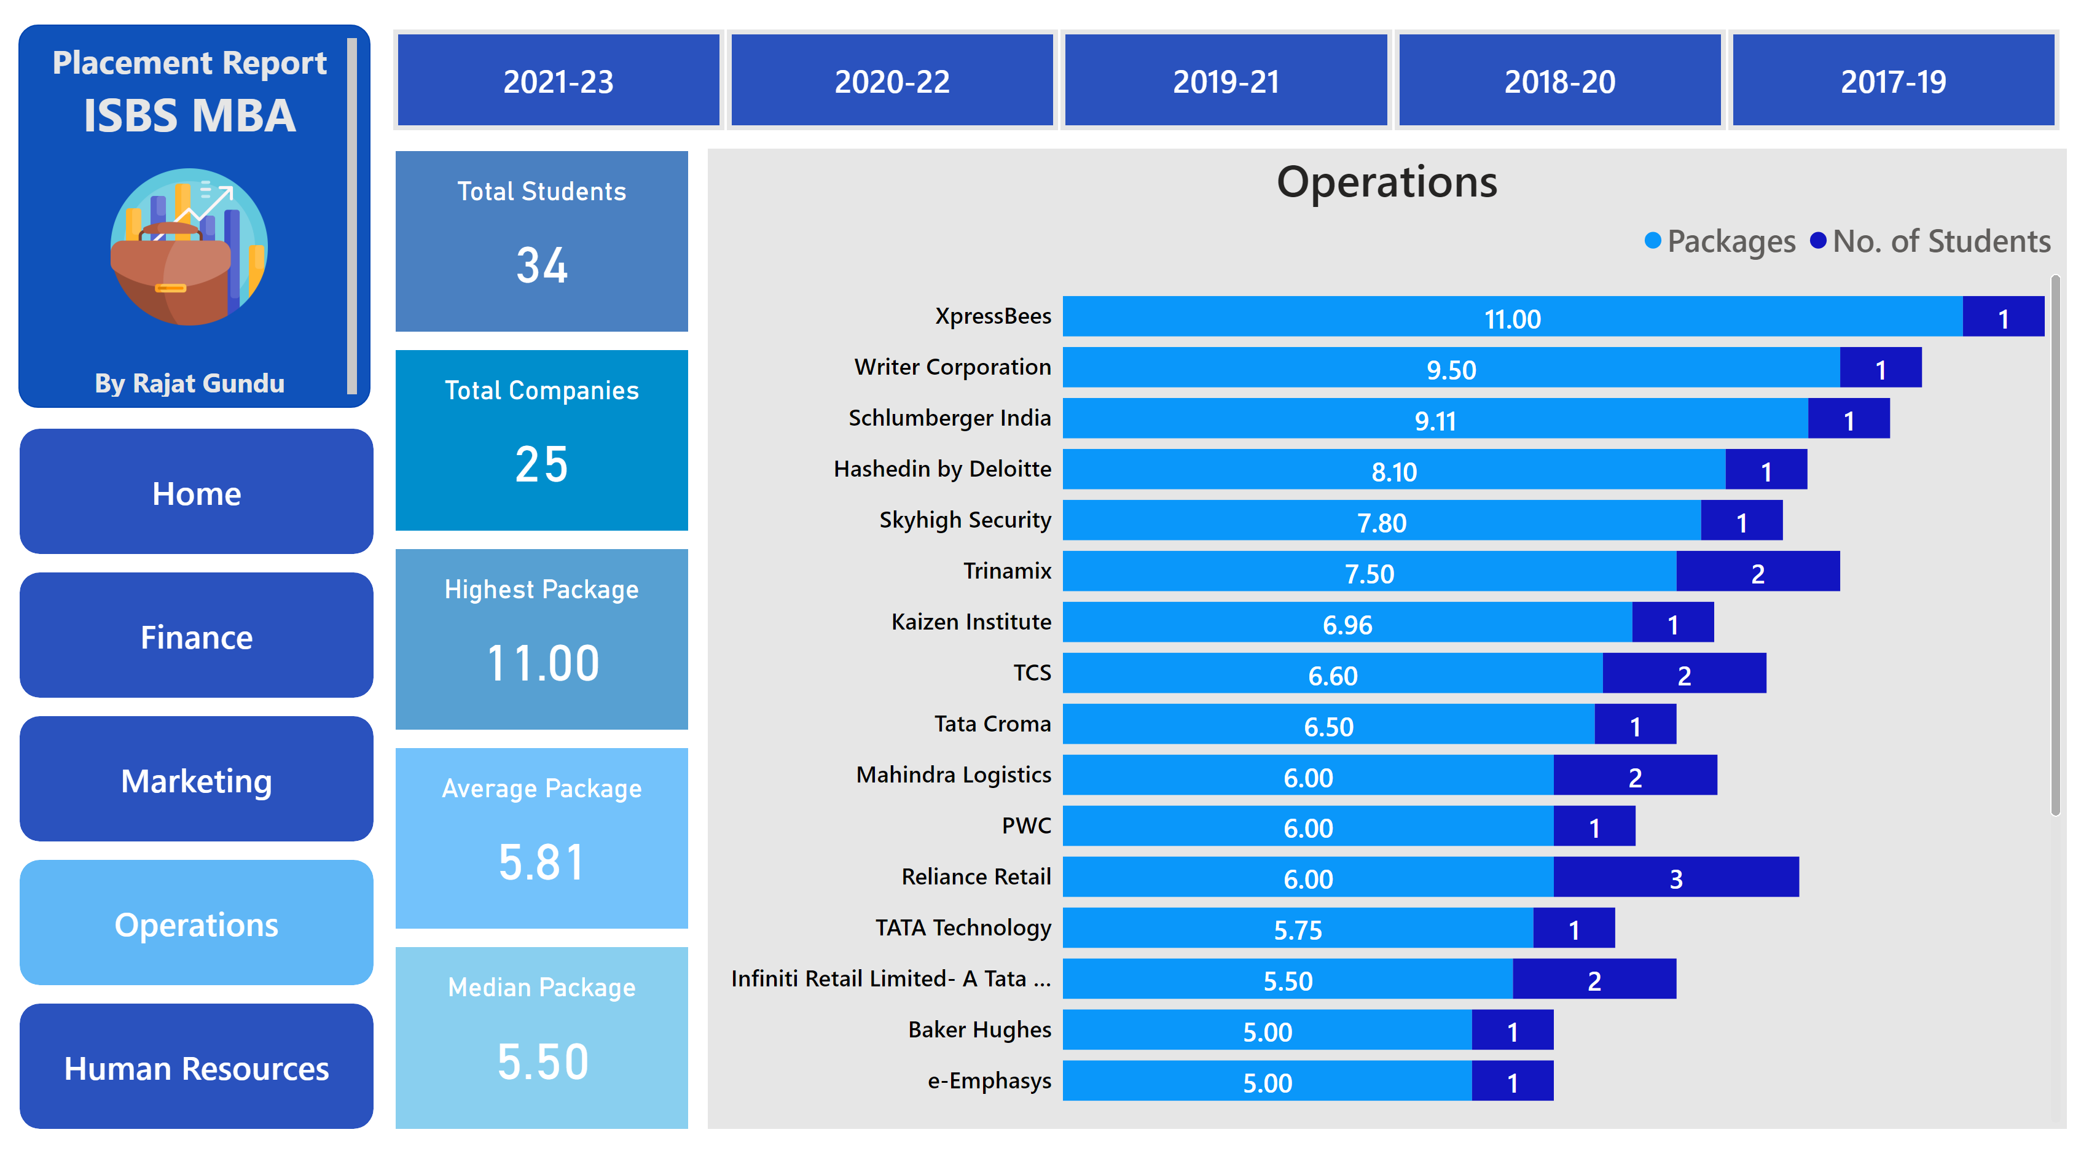
Operations
Notes:
textbox
No alt text provided
image
No alt text provided
slicer
No alt text provided
Operations
No alt text provided
shape
No alt text provided
shape
No alt text provided
shape
No alt text provided
shape
No alt text provided
shape
No alt text provided
Total Students
No alt text provided
Total Companies
No alt text provided
Highest Package
No alt text provided
Average Package
No alt text provided
Median Package
No alt text provided

Slide 6
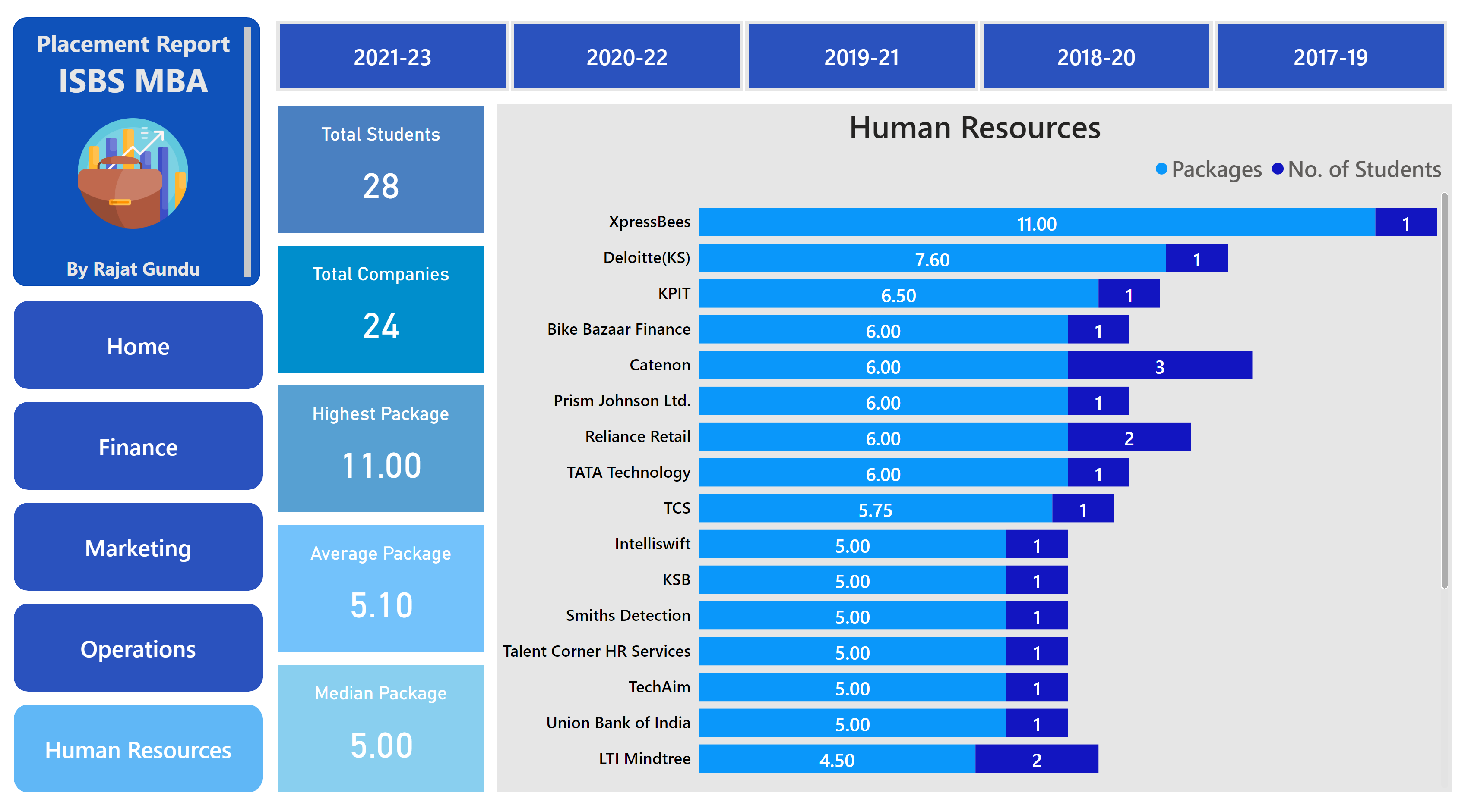
Human Resources
Notes:
textbox
No alt text provided
image
No alt text provided
slicer
No alt text provided
Human Resources
No alt text provided
shape
No alt text provided
shape
No alt text provided
shape
No alt text provided
shape
No alt text provided
shape
No alt text provided
Total Students
No alt text provided
Total Companies
No alt text provided
Highest Package
No alt text provided
Average Package
No alt text provided
Median Package
No alt text provided

